Slide 1
Are You sure?
David E. Bard, PhD
University of Oklahoma HSC
Center on Child Abuse and Neglect
Panel Discussion for Sand Diego International Conference on Child and Family Maltreatment

Slide 2
Overview
Why should we improve child maltreatment reporting?
What is wrong with the maltreatment identification system?
Can we improve child maltreatment identification? How might we? What if…?

Slide 3
Why should we improve child maltreatment reporting?
Need We?

Slide 4
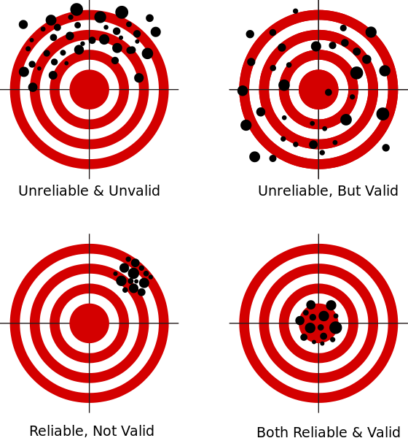
Can We Improve Identification of Child Maltreatment?
Are rates reliable?
Across states?
Within states?
Are reports valid?

Slide 5
State Child Abuse Reports/1000 Children/yr.

Slide 6
Consistency in Referral Rates Between States
If same reporting process + same population, single rate would suffice
Under this assumption, current rates demonstrate significant deviation from statistical expectations (i.e., variation in rates across states cannot be explained by single rate parameter)
BUT, process differences or population differences or both?
Assumption of same population is clearly flawed
BUT, population heterogeneity could affect both reporting (individual decision-making) and maltreatment behaviors
Notes:
Reporting process encapsulates individual decision-making from professionals along with the system used to capture and record an individual’s reporting actions
reporting

Slide 7
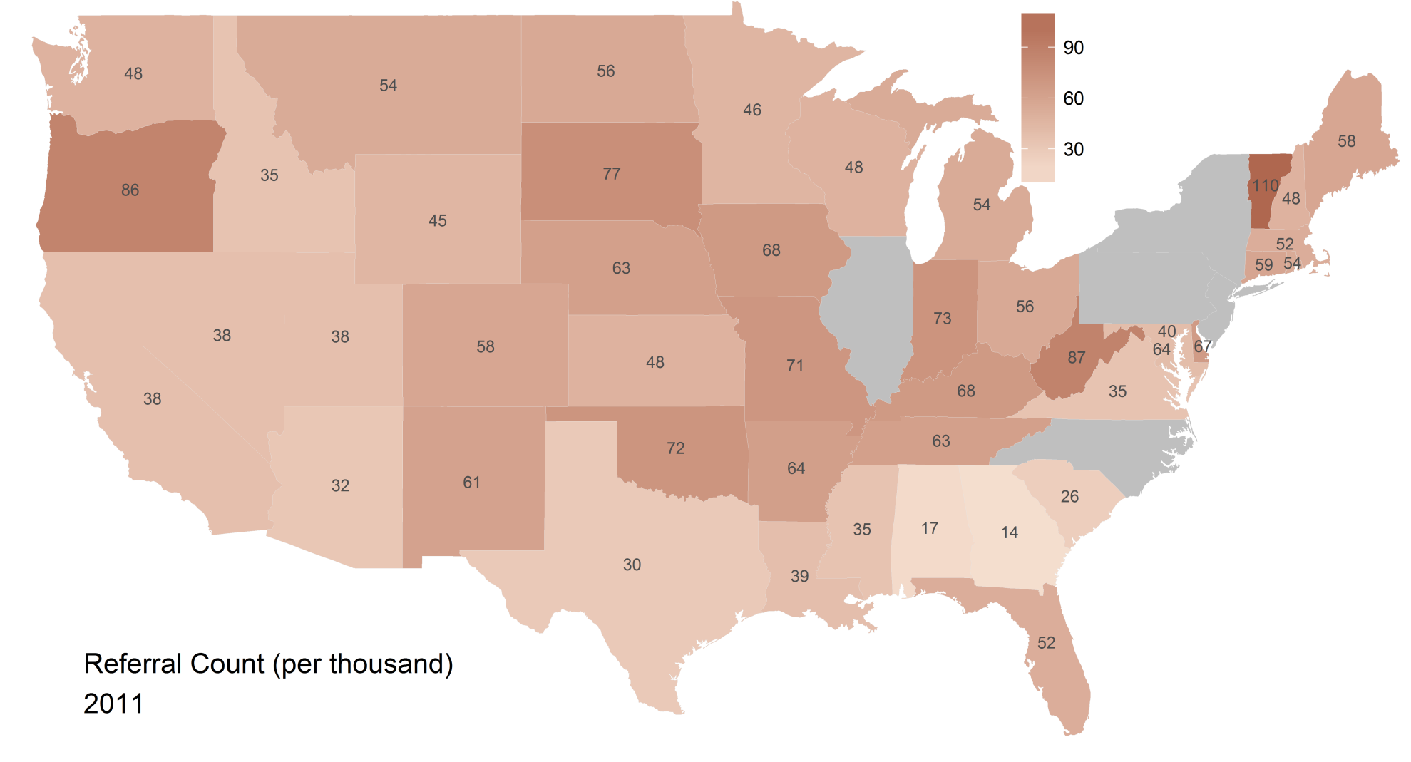
Significant Spatial Autocorrelation
Notes:
Spatial relationships soak up much of the overdispersion (unobserved heterogeneity), and this is undoubtedly partly due to population heterogeneity across large regions of the US. But, we cannot completely dismiss the hypothesis of differential referral processes, which also might evidence spatial similarities. A more careful analysis of this data should be carried out to control for known difference in population characteristics.
So we may or may not have a reliability problem with referrals. Let’s now look closer at some process variables that occur after a report surfaces.

Slide 8
Consistency Within States?
Relative to between state variation, within-state variation indicates much greater consistency
Nonetheless, within-state variation still defies statistical expectations even after control for general time trend
If same process + same population, single state rate would suffice
Single state rate does not fit data well!

Slide 9
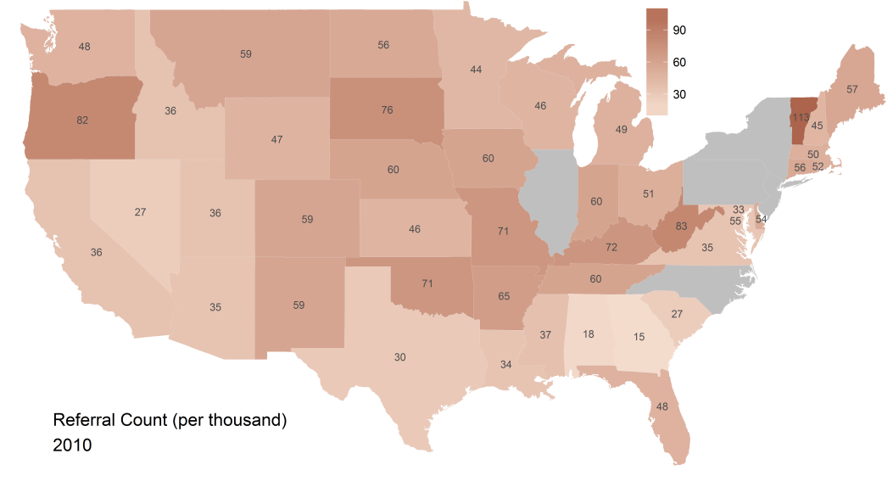

Within-State Referral Rate Comparison
Notes:
660000 child pop Nevada
4million+ pop in Florida

Slide 10
Consistency in Screen-Out Rate Across States
Rates widely discrepant
Within- and Between-State variation defies statistical expectation

Slide 11
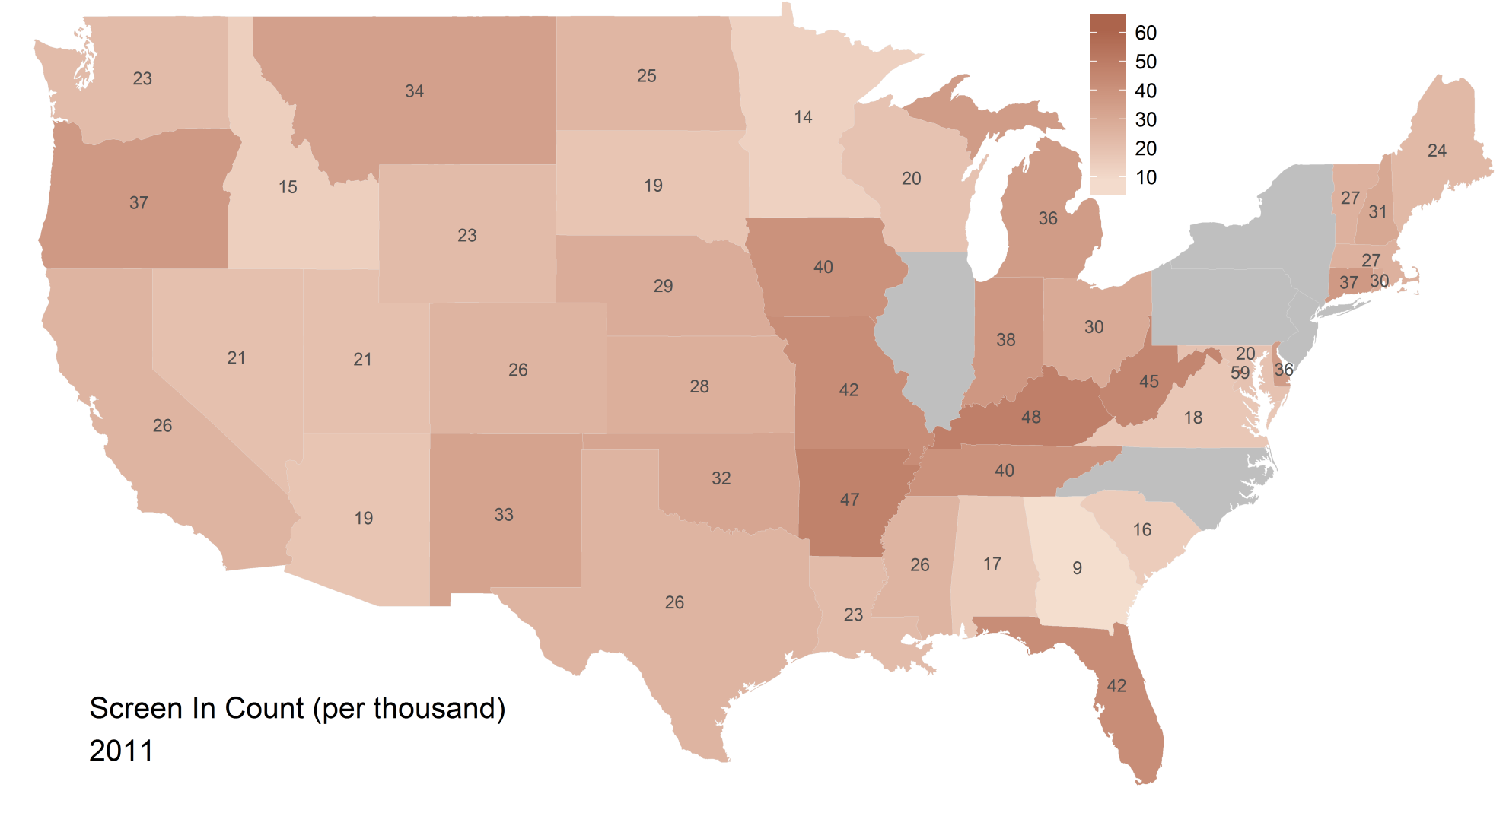
Screen-in Counts
Notes:
Some Consistency Improvement but still significant overdispersion within and between states.

Slide 12
Reliability of Maltreatment Identification
In a nutshell,
even if identification rates were valid, they appear to be highly unreliable

Slide 13
Validity of the Rates?
Hard to say other than under-detection appears to be the norm
Finkelhor et al., 2005
Caregiver & self-reported maltreatment: 124 per 1,000
Compare to referral rate range (2007-2011): 13.5 to 113 per 1,000
Over-detection?

Slide 14
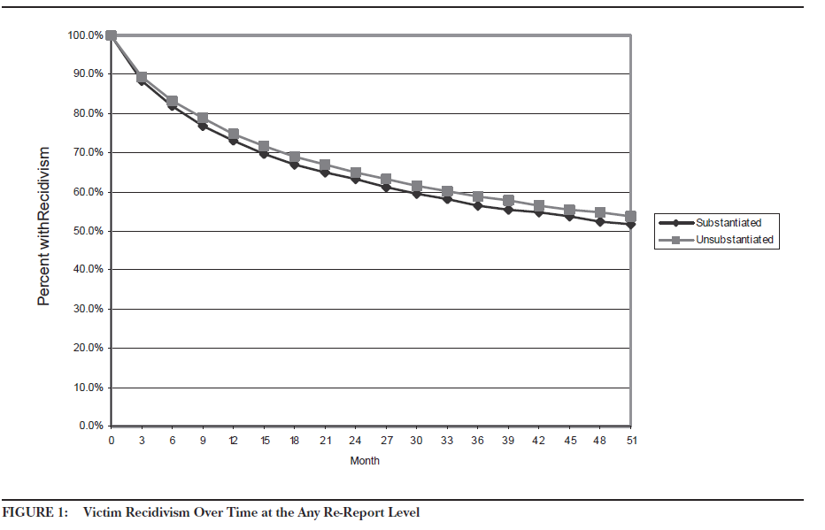
Validity in Substantiation/ Victim Rates
Historically poor indicator of maltreatment occurrence
Drake, Jonson-Reid, Way, & Chung, 2003;
Fluke, Parry, & Baumann, 2001

Slide 15
Validity of Maltreatment Identification
In a nutshell, reasonable minds disagree.
To advance, however, we need more convergence of evidence from these types of data

Slide 16
What is wrong with the maltreatment identification system?
Where do we start…

Slide 17
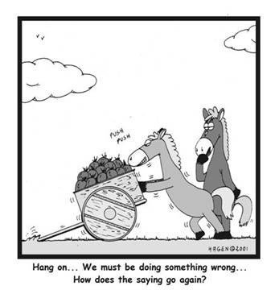
Uh oh! Poor Validity & Reliability
Notes:
Before we blame the professionals who report, maybe we ought to hold our horses and ask some basic, fundamental questions about what we are trying to measure

Slide 18
Validity = Measuring what you intend to measure
What are we measuring?
Need some consistency in definitions of maltreatment
Ruyan et al. (2005)
Compared MMCS (Barnett et al., 2003) and NIS-2 (Sedlak, 1986) classification systems
Cicchetti & Manly (2001)
Barnett et al. (1993)
Zuravin (1991)
Notes:
Modified version of the Maltreatment Classification System (MCS)
coding system used by the Second National Incidence Study (NIS-2) (Sedlak, 1986).

Slide 19
Reporting Biases
Individual decision-making processes
“The researchers agree that the decision-making process is complex, involving layers of factors that are not always acknowledged. Future research could further explore the various contexts, factors (e.g., case, personal, organizational, and external), and case features from which decision-making emerges.” (Child Welfare Information Gateway., 2003)
Over-detection and Under-detection
Lessons learned from Judgment and Decision-Making science
ala heuristics and biases
Notes:
Judgment heuristics and biases (ala Kahneman & Tversky)
Ambiguity effect, framing effects, belief bias, confirmation bias, conservatism, outcome bias
Utility maximization has to consider serious negative consequences of action, e.g., malpractice suits, loss of reputation, loss of patients, etc.
Loss aversion?
Personal responsibility to report (is there a diffusion of responsibility?)
Over-reporting?
Judgment heuristics and biases (ala Kahneman & Tversky)
Base rate neglect, pseudodiagnosticity, stereotype and framing effects
Individual variation in mental decisional threshold (ala signal detection theory)- some individuals carry around mental thresholds that are too low
Where should the “reasonable suspicion” threshold lie?

Slide 20
Climate and Culture of the Reporting Environment
Legal ease and mandates
Participant burden
Utility maximization
“Cost-savings” on true-positives? (Corso et al., 2008)
“Costs” of false-positives vs. false-negatives?

Slide 21
Can we improve child maltreatment identification? How might we? What if…?

Slide 22
Maltreatment Assessment Screener?
Broad-based, all-purpose screener?
Lofty goal
Time barriers
Narrow-based, behavior/type specific screener?
Brief behavior/symptom rating scale
Acceptable sensitivity/specificity?
Professional training to minimize bias and enhance consistency
The CARES study (Rojas et al.) vignette training
Feedback from CPS (but with MMCS or NIS-2 codes)

Slide 23
Utility of Psychological Assessment?
Youngstrom, E. (2013). Future directions in psychological assessment: Combining Evidence-Based Medicine innovations with psychology's historical strengths to enhance utility, J. Clin Child Adol Psych., 42, 139-159.
“EBM ties assessment directly to clinical decision making about the individual, uses simplified Bayesian methods explicitly to integrate assessment data, and solicits patient preferences as part of the decision-making process.”

Slide 24
Thank you!

